Slide 1


Machine learning
By Vaidansh Thapliyal

Slide 2
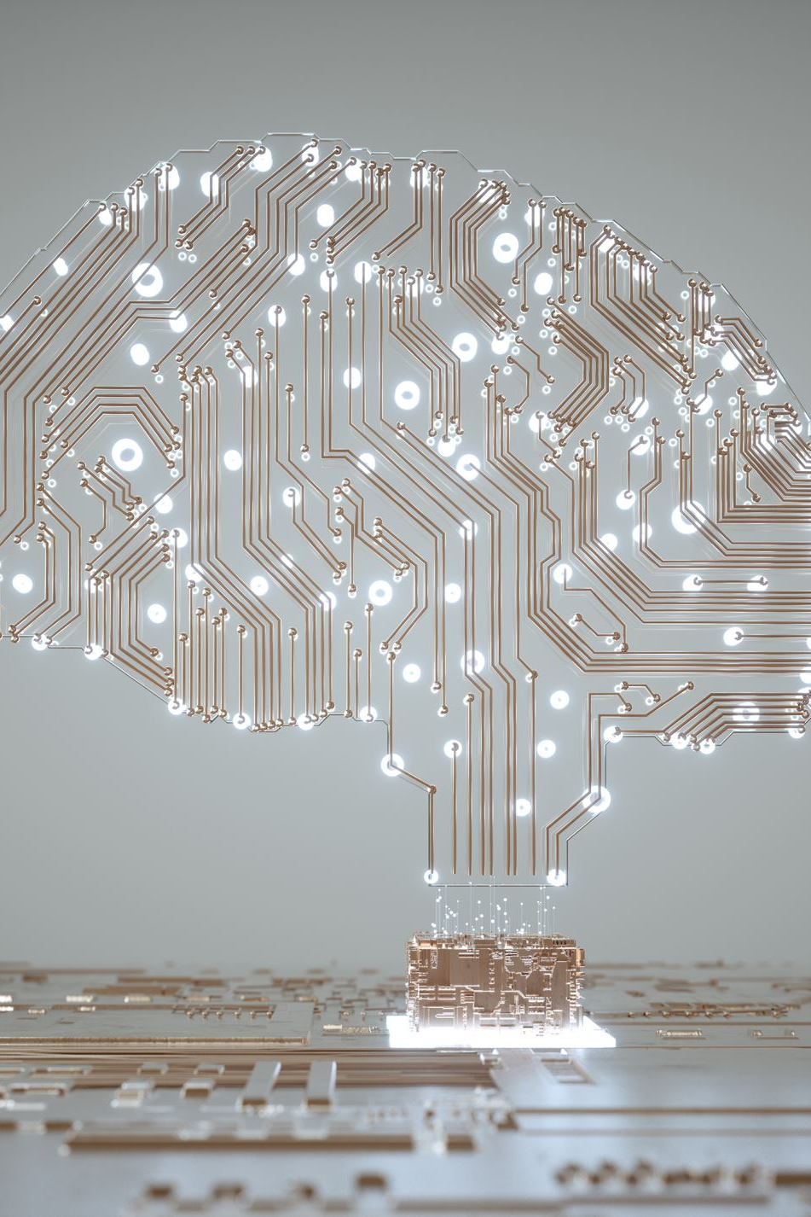
What is machine learning?
Machine learning is a branch of artificial intelligence and computer science which focuses on the use of data and algorithms to imitate the way that humans learn, gradually improving its accuracy.
Machine learning is an important component of the growing field of data science. Through the use of statistical methods, algorithms are trained to make classifications or predictions, and to uncover key insights in data mining projects. These insights subsequently drive decision making within applications and businesses, ideally impacting key growth metrics. As big data continues to expand and grow, the market demand for data scientists will increase.

Slide 3

Evolution of Machine Learning
Machine learning (ML) is an important tool for the goal of leveraging technologies around artificial intelligence. Because of its learning and decision-making abilities, machine learning is often referred to as AI, though, in reality, it is a subdivision of AI. Until the late 1970s, it was a part of AI’s evolution. Then, it branched off to evolve on its own. Machine learning has become a very important response tool for cloud computing and e-commerce, and is being used in a variety of cutting-edge technologies. Below is a brief history of machine learning and its role in data management.
Machine learning is a necessary aspect of modern business and research for many organizations today. It uses algorithms and neural network models to assist computer systems in progressively improving their performance.
Machine learning algorithms automatically build a mathematical model using sample data – also known as “training data” – to make decisions without being specifically programmed to make those decisions.

Slide 4

Benefits of Machine Learning
Machine learning is a powerful technology that can help you find patterns and relationships within your data.
Find trends and patterns – Machine learning discovers hidden information in your data. You might already be aware of important patterns as a result of working with your data over time. Machine learning can confirm or qualify such empirical observations in addition to finding new patterns that are not immediately distinguishable through simple observation.
Make data driven decisions – Many companies have big data and extracting meaningful information from that data is important in making data driven business decisions. By leveraging machine learning algorithms, organizations are able to transform data into knowledge and actionable intelligence.
Recommend products – Machine learning results can also be used to influence customer decisions by promoting or recommending relevant and useful products based on behavior patterns of customers online or their response to a marketing campaign.

Slide 5
Benefits of Machine Learning
Detect fraud, anomalies, and security risks – The Financial Services sector has benefited from machine learning algorithms and techniques by discovering unusual patterns or fraud and responding to new fraud behaviors much more quickly. Today companies and governments are conducting business and sharing information online. In such cases, network security is a concern. Machine learning can help in detecting anomalous behavior and automatically take corrective actions.
Retail analysis – Machine learning helps to analyze customer purchase patterns to provide promotional offers for target customers. This service ensures superior customer experience and improves customer loyalty.
Healthcare – Machine learning in medical use is becoming common, helping patients and doctors. Advanced machine learning techniques are used in radiology to make an intelligent decision by reviewing images such as radiographs, CT, MRI, PET images, and radiology reports. It is reported that machine learning-based automatic detection and diagnosis are at par or better than the diagnosis of an actual radiologist. Some of the machine learning applications are trained to detect breast cancer.

Slide 6
Types of Machine Learning
Machine learning is a subset of AI, which enables the machine to automatically learn from data, improve performance from past experiences, and make predictions. Machine learning contains a set of algorithms that work on a huge amount of data. Data is fed to these algorithms to train them, and on the basis of training, they build the model & perform a specific task.These ML algorithms help to solve different business problems like Regression, Classification, Forecasting, Clustering, and Associations, etc.Based on the methods and way of learning, machine learning is divided into mainly four types, which are:
Supervised Machine LearningUnsupervised Machine LearningSemi-Supervised Machine LearningReinforcement Learning

Slide 7

Supervised Machine Learning
As its name suggests, supervised machine learning is based on supervision. It means in the supervised learning technique, we train the machines using the “labelled” dataset, and based on the training, the machine predicts the output. Here, the labelled data specifies that some of the inputs are already mapped to the output.
Advantages and Disadvantages of Supervised Learning are :
Advantages:
Since supervised learning work with the labelled dataset so we can have an exact idea about the classes of objects.
These algorithms are helpful in predicting the output on the basis of prior experience.
Disadvantages:
These algorithms are not able to solve complex tasks.
It may predict the wrong output if the test data is different from the training data.
It requires lots of computational time to train the algorithm.

Slide 8
Unsupervised Machine Learning
Unsupervised learning is different from the Supervised learning technique; as its name suggests, there is no need for supervision. It means, in unsupervised machine learning, the machine is trained using the unlabeled dataset, and the machine predicts the output without any supervision.
Advantages and Disadvantages of Unsupervised Learning Algorithm are:
Advantages:
These algorithms can be used for complicated tasks compared to the supervised ones because these algorithms work on the unlabeled dataset.
Unsupervised algorithms are preferable for various tasks as getting the unlabeled dataset is easier as compared to the labelled dataset.
Disadvantages:
The output of an unsupervised algorithm can be less accurate as the dataset is not labelled, and algorithms are not trained with the exact output in prior.
Working with Unsupervised learning is more difficult as it works with the unlabeled dataset that does not map with the output.

Slide 9

Semi-Supervised Learning
Semi-Supervised learning is a type of Machine Learning algorithm that lies between Supervised and Unsupervised machine learning. It represents the intermediate ground between Supervised (With Labelled training data) and Unsupervised learning (with no labelled training data) algorithms and uses the combination of labelled and unlabeled datasets during the training period.
Advantages and disadvantages of Semi-supervised Learning
Advantages:
It is simple and easy to understand the algorithm.
It is highly efficient.It is used to solve drawbacks of Supervised and Unsupervised Learning algorithms.
Disadvantages:
Iterations results may not be stable.
We cannot apply these algorithms to network-level data.Accuracy is low.

Slide 10

Reinforcement Learning
Reinforcement learning works on a feedback-based process, in which an AI agent (A software component) automatically explore its surrounding by hitting & trail, taking action, learning from experiences, and improving its performance.
Advantages and Disadvantsges are :
Advantages
It helps in solving complex real-world problems which are difficult to be solved by general techniques.
The learning model of RL is similar to the learning of human beings; hence most accurate results can be found.Helps in achieving long term results.
Disadvantage
RL algorithms are not preferred for simple problems.
RL algorithms require huge data and computations.
Too much reinforcement learning can lead to an overload of states which can weaken the results.The curse of dimensionality limits reinforcement learning for real physical systems.

Slide 11

Conclusion
This tutorial has introduced you to Machine Learning. Now, you know that Machine Learning is a technique of training machines to perform the activities a human brain can do, albeit bit faster and better than an average human-being. Today we have seen that the machines can beat human champions in games such as Chess, AlphaGO, which are considered very complex. You have seen that machines can be trained to perform human activities in several areas and can aid humans in living better lives.
Machine Learning can be a Supervised or Unsupervised. If you have lesser amount of data and clearly labelled data for training, opt for Supervised Learning. Unsupervised Learning would generally give better performance and results for large data sets.

